Slide 1
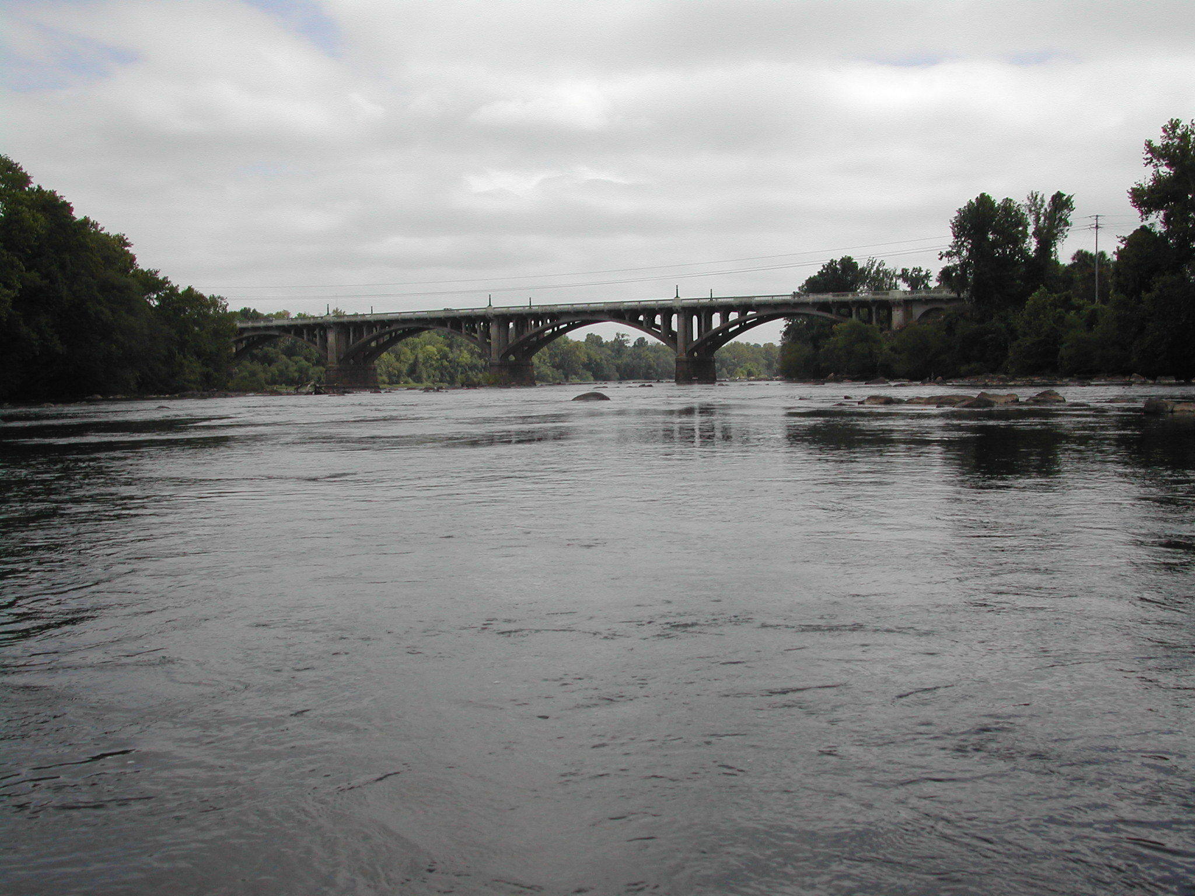
Multiple Input Transfer Function Modeling for Streamflow Data
Samuel T. Croker

Slide 2
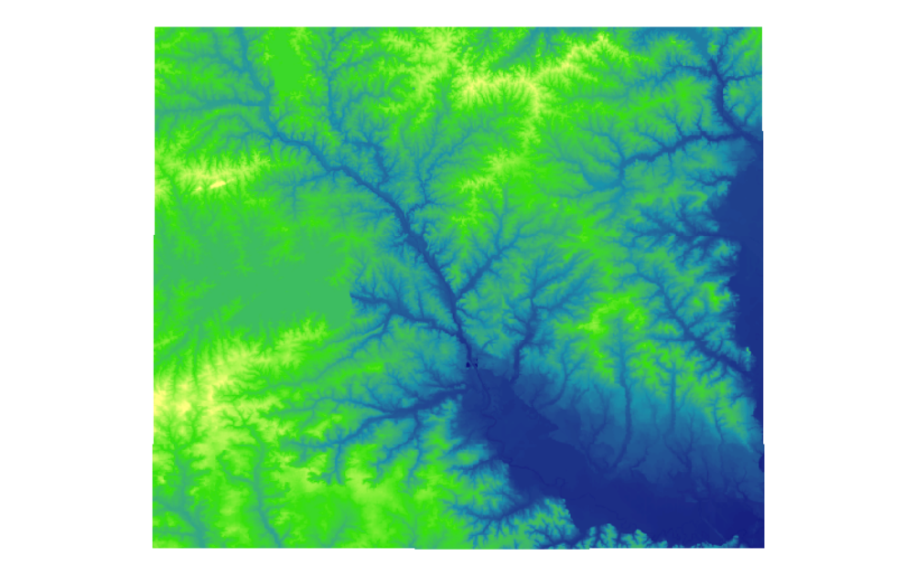
The Saluda-Broad-Congaree River System

Slide 3
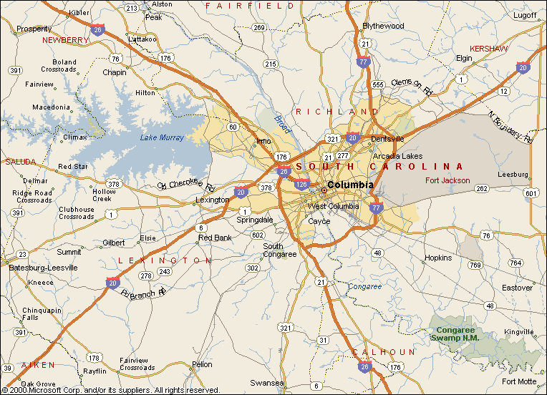

Slide 4
Data Definition
Streamflow
  Cross-sectional cubic feet per second
  Complicated Measurement
Stage
  Height of water surface above a set point
  Simple measurement

Slide 5
Monitoring Stations
River | Station Name | Station | Altitude | Drainage Area
Broad | Alston | 02161000 | 211.91 ft. | 4790 mi²
Saluda | Below LM Dam | 02168504 | 170 ft. | 2420 mi²
Saluda | Above Columbia | 02169000 | 149.46 ft. | 2520 mi²
Congaree | Columbia | 02169500 | 113.02 ft. | 7850 mi²
Congaree | Congaree Swamp NP | 02169625 | 90.84 ft. | 8290 mi²

Slide 6
System Setup
Segment 1
  Output
    Congaree at Columbia
  Inputs
    Broad River at Alston (24 miles)
    Saluda River Below Lake Murray Dam (10 miles)
Segment 2
  Output
    Congaree Swamp National Park
  Input
    Congaree at Columbia (25 miles)

Slide 7
Preparation of the Data
Time segment selection
Missing values
Transformations
  Log Transformed Streamflow
  Raw Stage

Slide 8
Model Fitting Generalities
SAS 9.1.3
PROC ARIMA for Model Fitting
PROC SPECTRA

Slide 9
Finding Model Parameters
Prewhitening Filters and Model Parameters
  ACF and PACF for Input and Output Series
Delay
  CCF
  Cross Spectrum
Transfer Function
  1 Numerator and 1 Denominator term best

Slide 10
Model Fitting and Diagnostics
Residual autocorrelation
Cross correlation
Residual noise series
Stability of forecasts

Slide 11
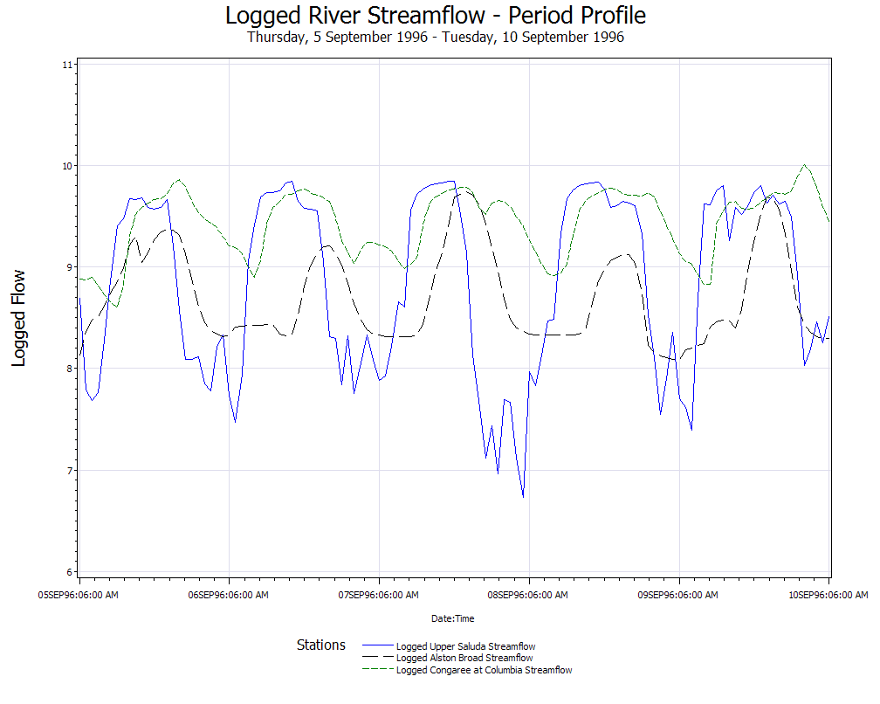

Slide 12
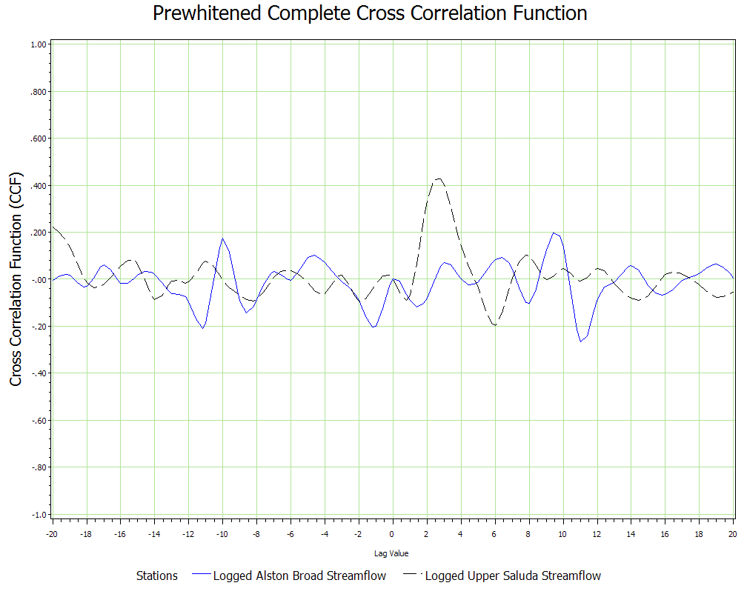

Slide 13
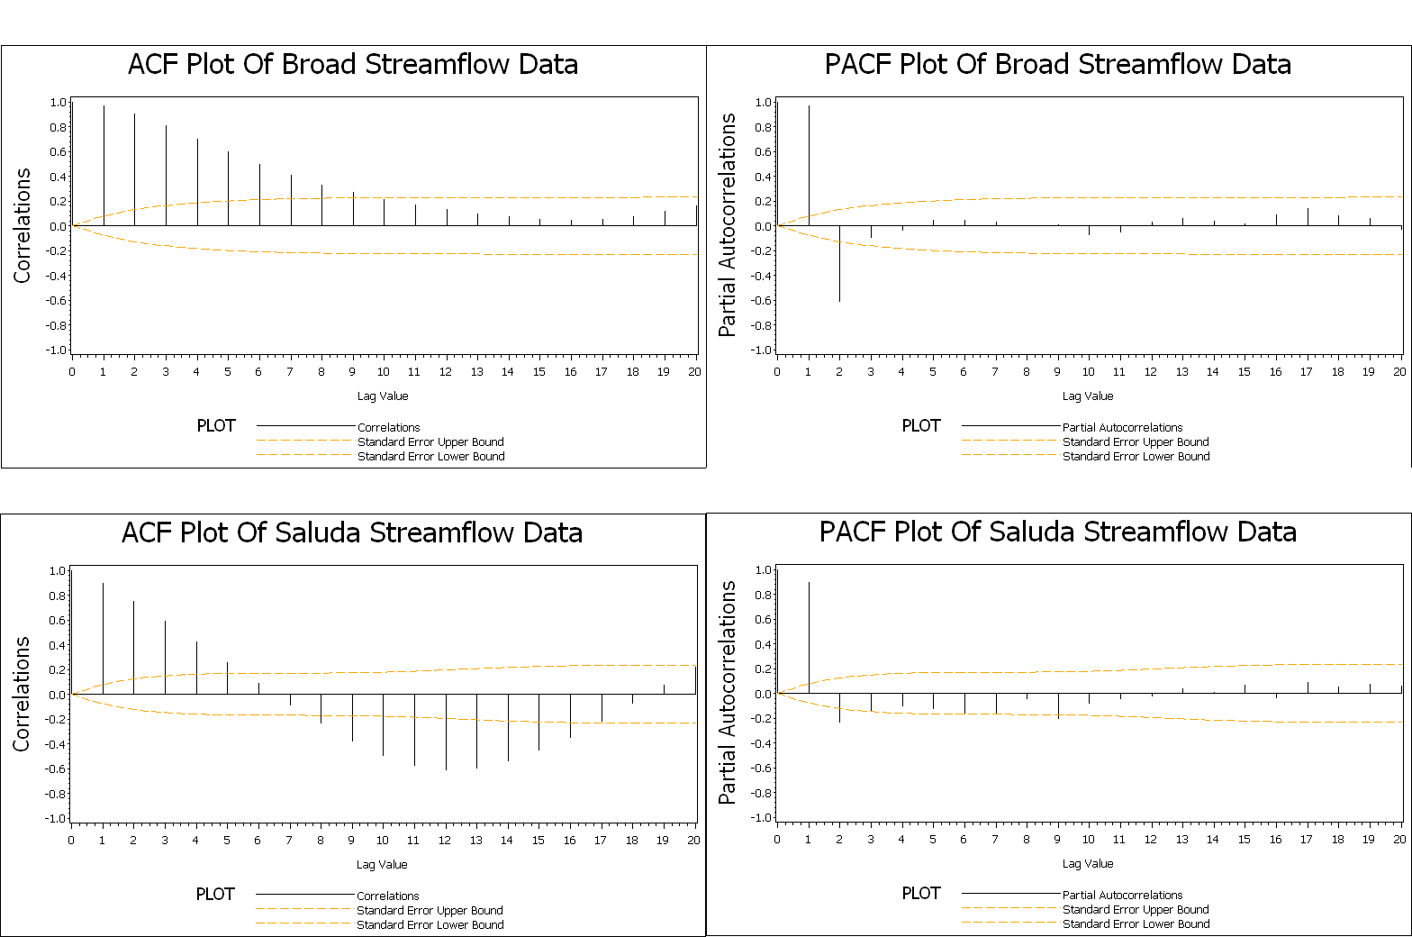

Slide 14
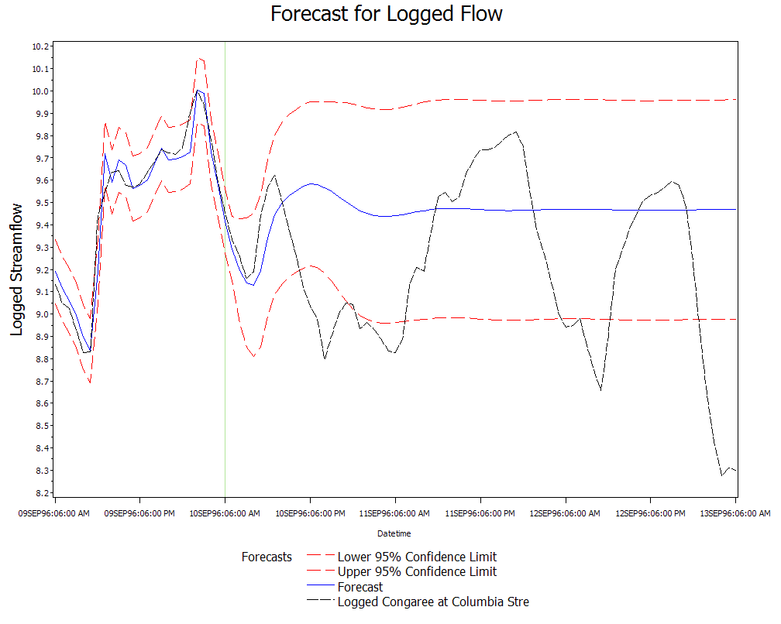

Slide 15
Model Fit Diagnostics
Autocorrelation Check of Residuals
To Chi- Pr >
Lag Square DF ChiSq --------------------Autocorrelations--------------------
6 1.28 3 0.7334 -0.001 -0.023 0.075 -0.064 0.028 0.007
12 10.69 9 0.2974 0.028 -0.006 -0.183 0.142 0.073 -0.128
18 13.53 15 0.5618 0.098 -0.059 -0.085 0.013 -0.040 0.001
24 17.31 21 0.6919 -0.093 0.014 -0.013 -0.078 0.074 -0.081
Crosscorrelation Check of Residuals with Input logsal8504_flow
To Chi- Pr >
Lag Square DF ChiSq --------------------Crosscorrelations-------------------
5 5.14 4 0.2734 -0.028 -0.048 -0.082 -0.143 0.133 0.010
11 9.25 10 0.5088 -0.107 0.078 -0.101 0.086 0.016 -0.055
17 9.96 16 0.8688 -0.033 0.036 0.002 0.013 -0.021 0.060
23 13.25 22 0.9259 0.002 -0.028 0.034 -0.038 0.146 0.078
Crosscorrelation Check of Residuals with Input logals1000_flow
To Chi- Pr >
Lag Square DF ChiSq --------------------Crosscorrelations-------------------
5 3.49 4 0.4787 0.066 -0.127 0.082 -0.074 0.047 0.004
11 9.04 10 0.5284 -0.083 -0.072 -0.040 0.125 0.145 -0.070
17 9.96 16 0.8687 0.073 0.042 -0.027 -0.010 0.035 -0.003
23 13.98 22 0.9024 -0.076 -0.133 -0.123 -0.018 0.036 -0.007

Slide 16
Logged Streamflow Residuals
The ARIMA Procedure
Autocorrelation Check for White Noise
To Chi- Pr >
Lag Square DF ChiSq --------------------Autocorrelations--------------------
6 1.45 6 0.9625 -0.011 -0.026 0.073 -0.077 0.021 0.011
12 12.06 12 0.4406 0.035 -0.015 -0.197 0.159 0.068 -0.126
18 14.65 18 0.6861 0.098 -0.059 -0.077 0.019 -0.025 -0.012
Squared Canonical Correlation Estimates
Lags MA 0 MA 1 MA 2 MA 3 MA 4 MA 5
AR 0 0.0001 0.0007 0.0055 0.0062 0.0005 0.0001
AR 1 0.0007 <.0001 0.0010 0.0004 0.0003 0.0004
AR 2 0.0056 0.0010 0.0004 <.0001 0.0005 0.0009
AR 3 0.0065 0.0003 <.0001 <.0001 0.0005 0.0006
AR 4 0.0007 0.0001 0.0003 0.0005 <.0001 <.0001
AR 5 <.0001 0.0007 0.0010 0.0006 <.0001 <.0001
SCAN Chi-Square[1] Probability Values
Lags MA 0 MA 1 MA 2 MA 3 MA 4 MA 5
AR 0 0.9105 0.7826 0.4393 0.4149 0.8240 0.9030
AR 1 0.7810 0.9759 0.7870 0.8704 0.8669 0.8458
AR 2 0.4348 0.7884 0.8829 0.9897 0.8306 0.7851
AR 3 0.4017 0.8849 0.9920 0.9573 0.8587 0.8170
AR 4 0.7868 0.9041 0.8622 0.8692 0.9986 0.9549
AR 5 0.9622 0.7901 0.8063 0.8316 0.9544 0.9921
ARMA(p+d,q)
Tentative
Order
Selection
Tests
----SCAN---
p+d q
0 0
(5% Significance Level)

Slide 17
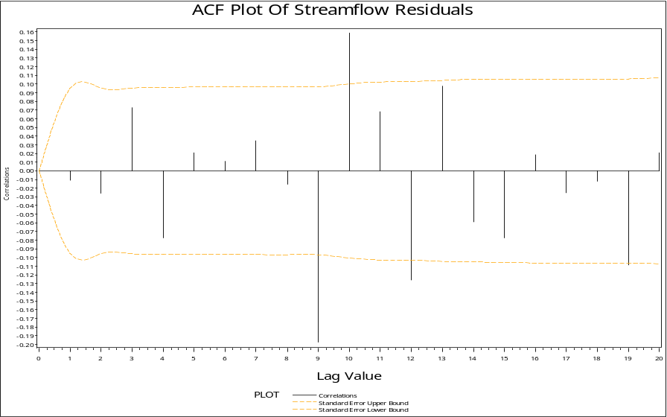

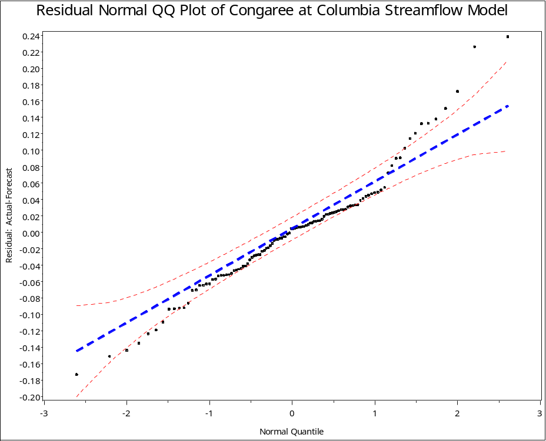

Slide 18
Streamflow Model for September 5-10, 1996
Saluda River Input Series
  ARMA(2,1)
  Delay = 3
Broad River Input Series
  ARMA(2,0)
  Delay = 10
Model Parameters
  -ARMA(2,1)

Slide 19
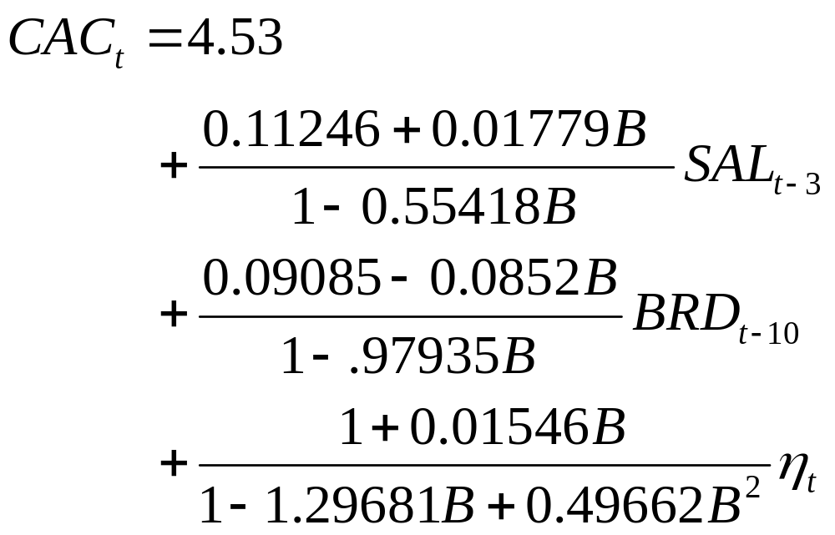
Streamflow Model for 5-10 September, 1996

Slide 20
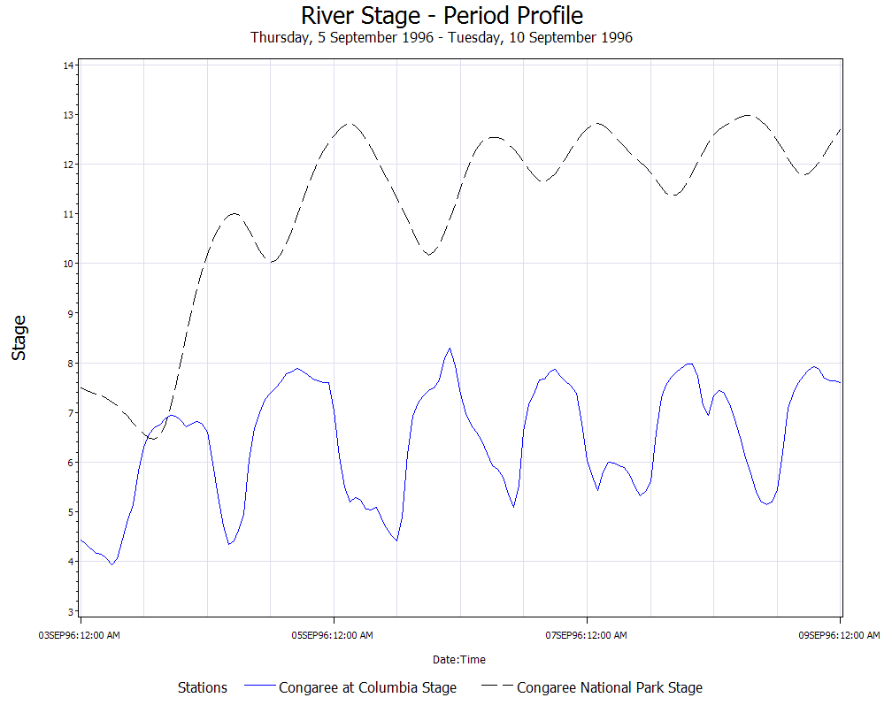

Slide 21
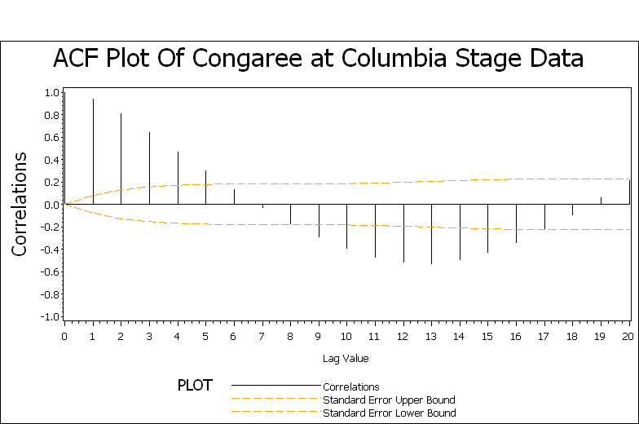
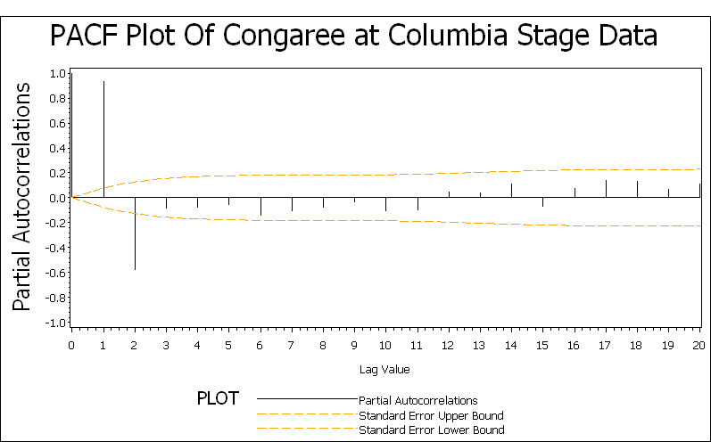
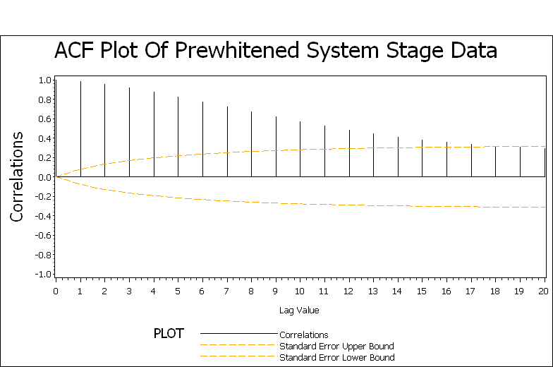
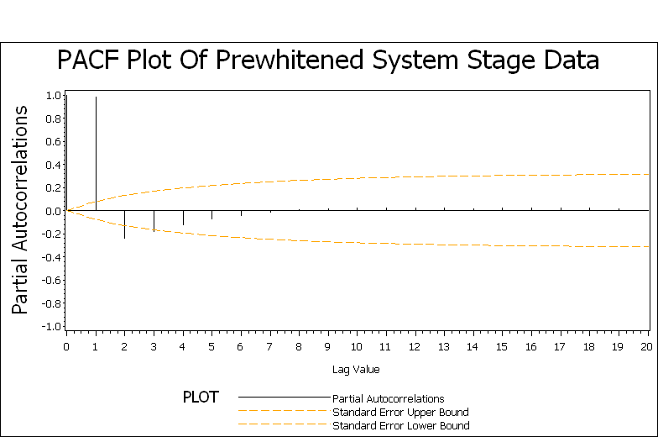

Slide 22
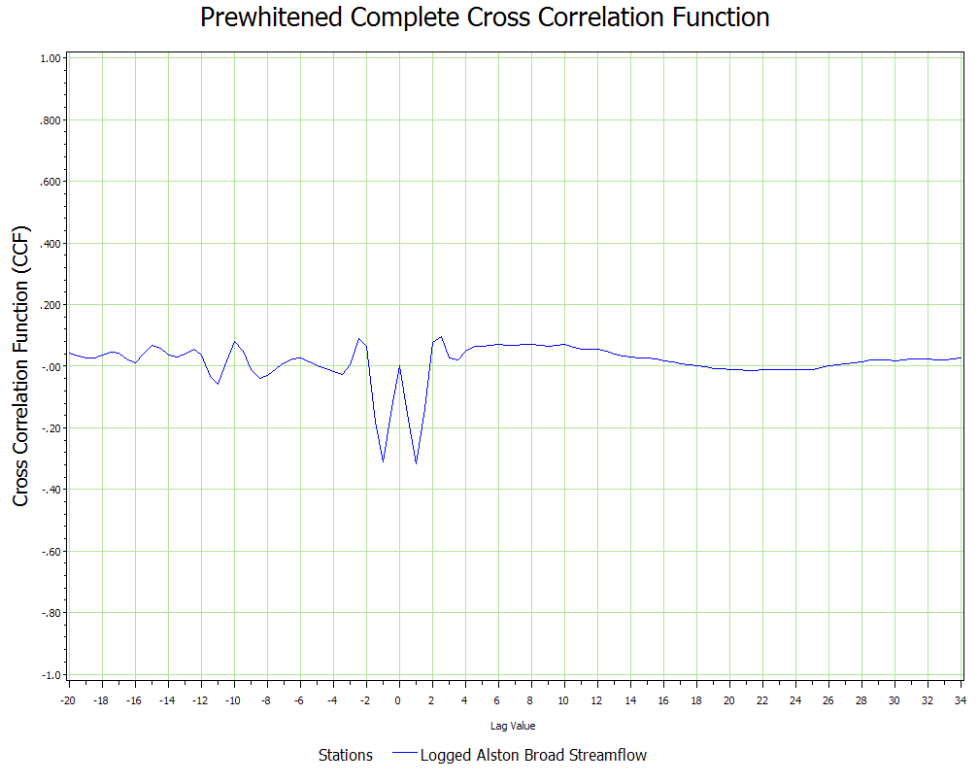

Slide 23
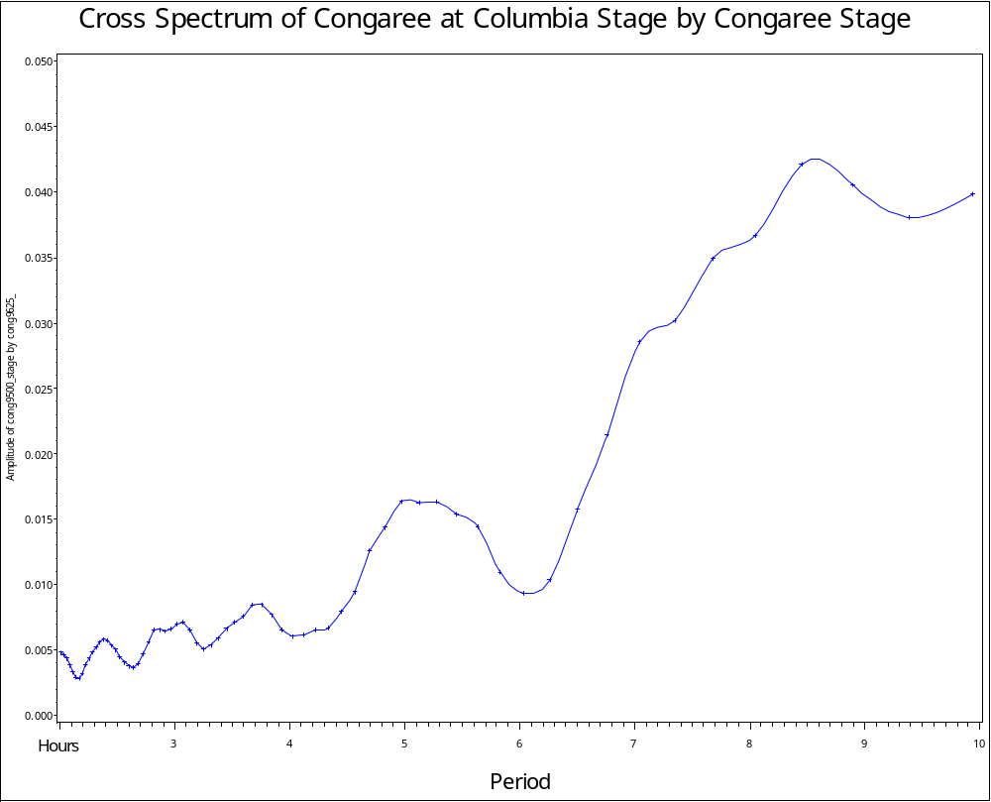

Slide 24
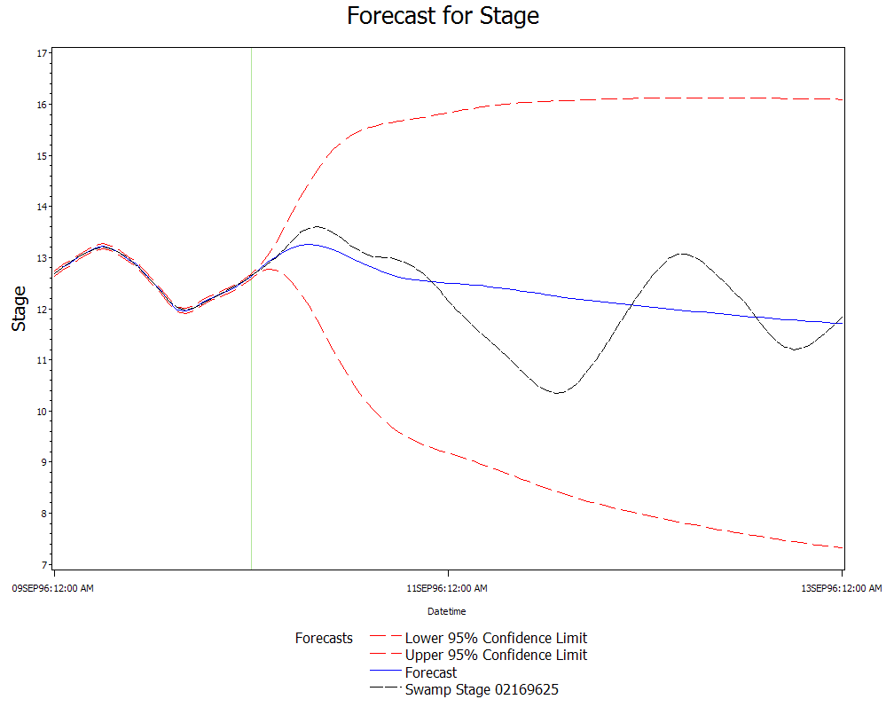

Slide 25
Stage Model
Congaree at Columbia Input Series
  ARMA(2,1)
  Delay = 9
Prewhitening Filter
  -ARMA(3,2)

Slide 26
Stage Model Diagnostics
Autocorrelation Check of Residuals
To Chi- Pr >
Lag Square DF ChiSq --------------------Autocorrelations--------------------
6 3.34 1 0.0676 0.001 -0.037 -0.012 -0.107 0.006 -0.085
12 6.66 7 0.4650 0.068 -0.046 -0.012 0.016 0.102 -0.041
18 14.13 13 0.3647 -0.013 -0.085 -0.169 0.000 -0.055 0.056
24 25.22 19 0.1534 0.051 -0.061 0.158 0.050 0.088 0.134
30 29.49 25 0.2441 -0.005 -0.043 -0.098 0.032 0.028 0.092
Crosscorrelation Check of Residuals with Input cong9500_stage
To Chi- Pr >
Lag Square DF ChiSq --------------------Crosscorrelations-------------------
5 1.73 4 0.7855 0.004 0.032 -0.037 -0.086 -0.005 0.042
11 7.54 10 0.6732 -0.025 -0.110 0.005 -0.147 -0.050 -0.044
17 18.63 16 0.2885 -0.067 0.059 0.006 -0.064 0.014 0.248
23 22.81 22 0.4124 0.135 0.007 -0.025 0.000 -0.083 0.045
29 26.43 28 0.5495 0.147 -0.029 0.027 0.027 0.005 -0.017
35 33.57 34 0.4884 -0.055 0.010 -0.070 -0.182 -0.033 0.074

Slide 27
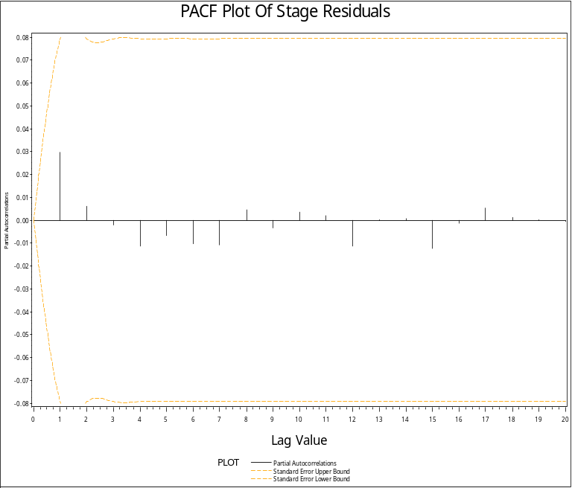
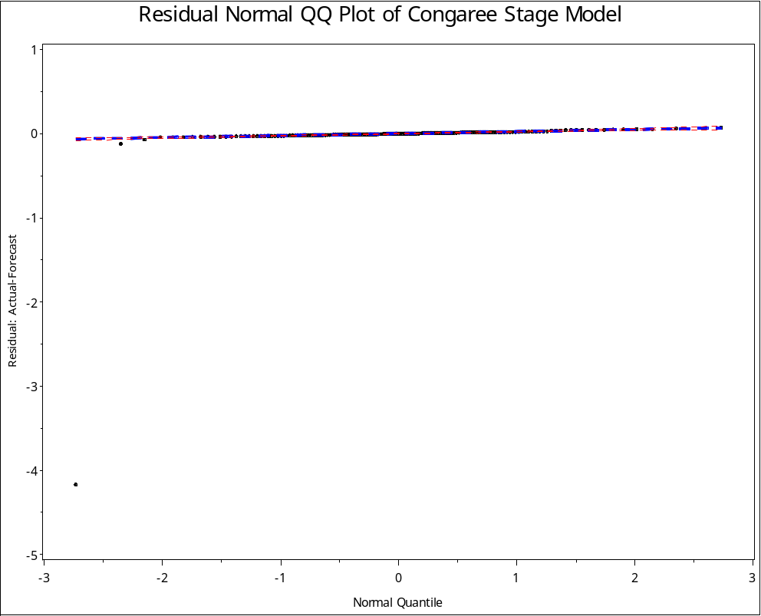
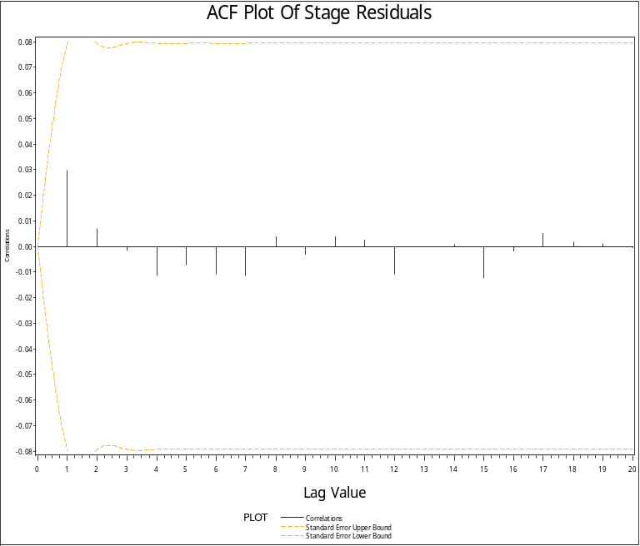

Slide 28
Stage Residual Diagnostics
Stage Residual Diagnostics
The ARIMA Procedure
Autocorrelation Check for White Noise
To Chi- Pr >
Lag Square DF ChiSq --------------------Autocorrelations--------------------
6 0.20 6 0.9998 0.030 0.007 -0.002 -0.011 -0.007 -0.011
12 0.25 12 1.0000 -0.011 0.004 -0.003 0.004 0.003 -0.011
18 0.28 18 1.0000 -0.000 0.001 -0.012 -0.002 0.005 0.002
Squared Canonical Correlation Estimates
Lags MA 0 MA 1 MA 2 MA 3 MA 4 MA 5
AR 0 0.0714 0.0040 0.0002 0.0110 0.0047 0.0104
AR 1 0.0246 0.0046 0.0012 0.0003 <.0001 <.0001
AR 2 0.0332 0.0020 0.0001 <.0001 0.0002 0.0001
AR 3 0.0166 <.0001 0.0006 <.0001 <.0001 <.0001
AR 4 0.0181 <.0001 0.0018 0.0012 <.0001 <.0001
AR 5 0.0186 0.0043 0.0030 <.0001 0.0002 <.0001
SCAN Chi-Square[1] Probability Values
Lags MA 0 MA 1 MA 2 MA 3 MA 4 MA 5
AR 0 0.0006 0.4242 0.8468 0.1913 0.3976 0.2113
AR 1 0.0471 0.4222 0.7046 0.8628 0.9155 0.9486
AR 2 0.0214 0.6392 0.9035 0.9657 0.8746 0.9227
AR 3 0.1060 0.9567 0.7810 0.9953 0.9707 0.9863
AR 4 0.0926 0.9230 0.6619 0.7230 0.9799 0.9823
AR 5 0.0890 0.4316 0.5819 0.9227 0.8930 0.9841

Slide 29
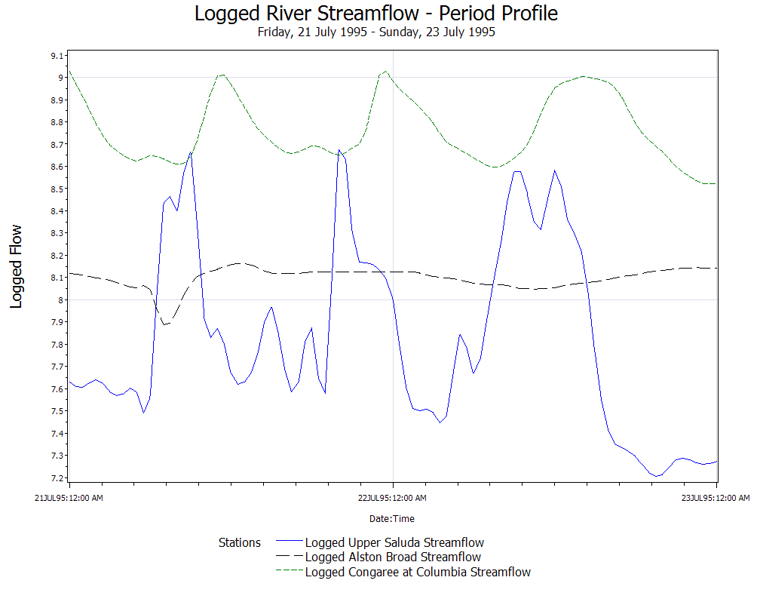
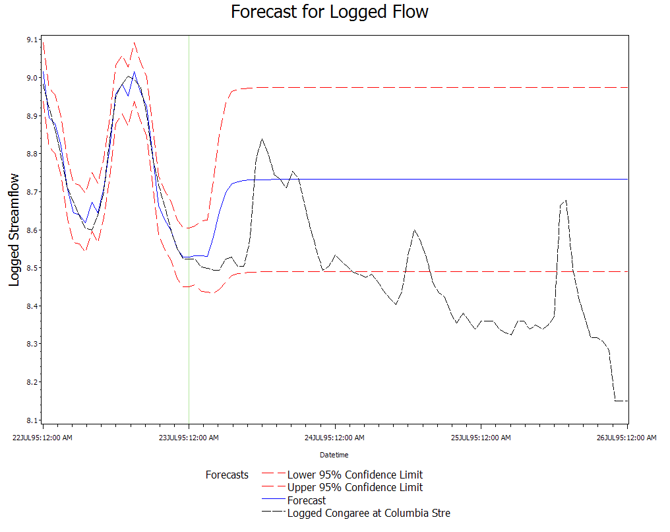
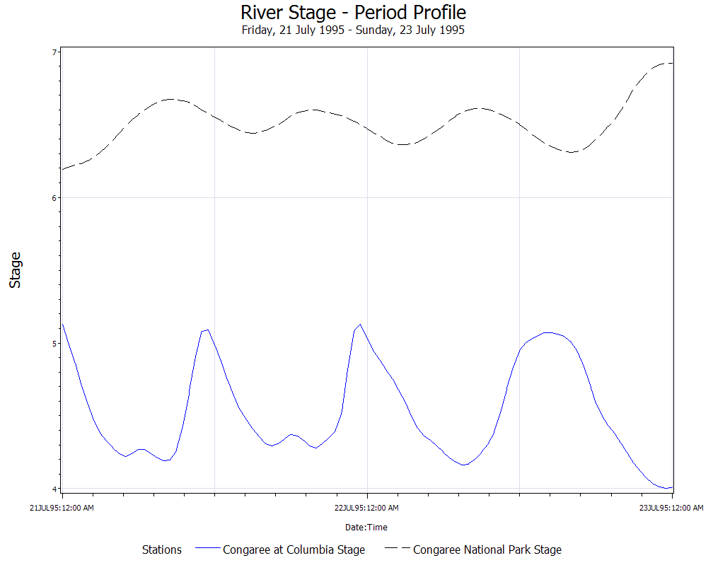
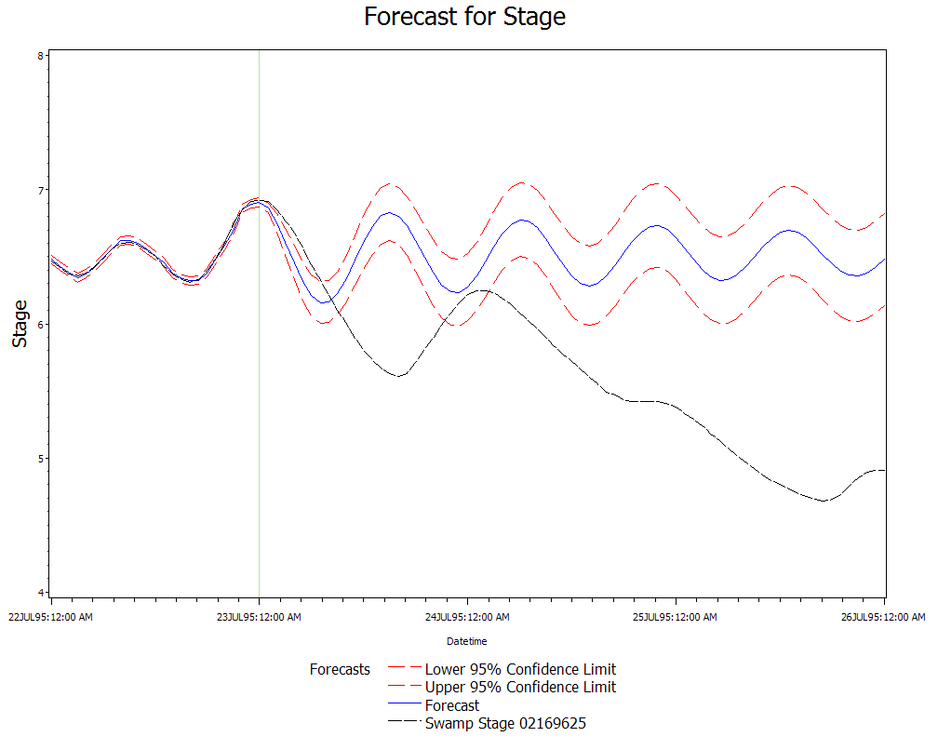

Slide 30
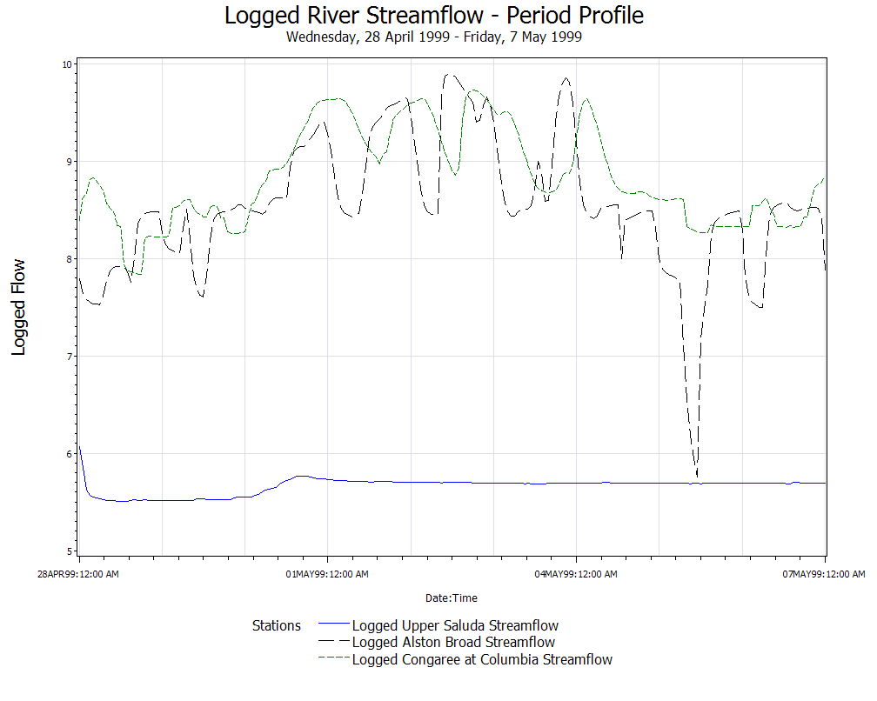
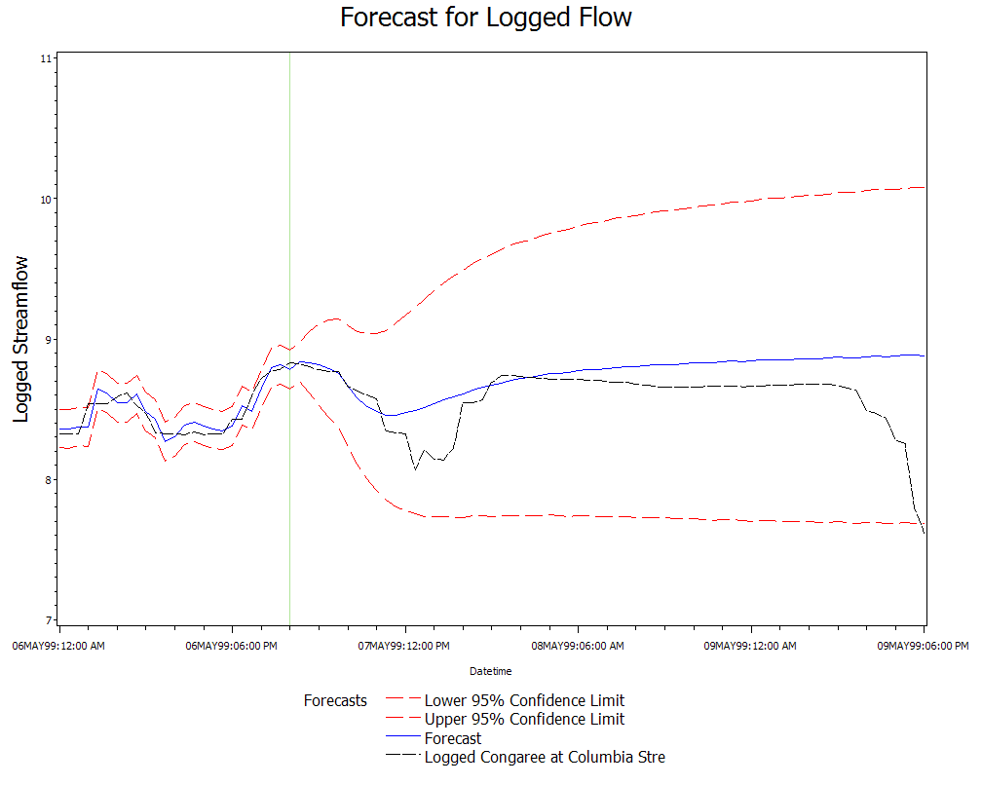
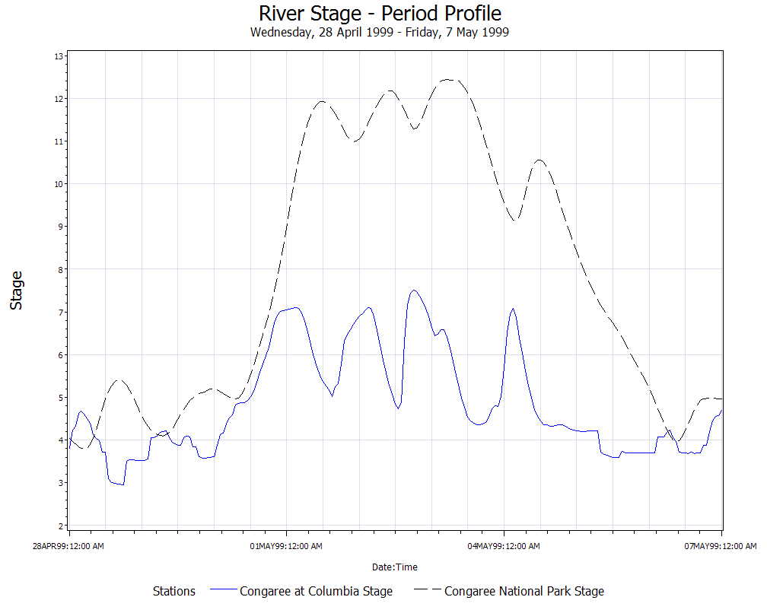
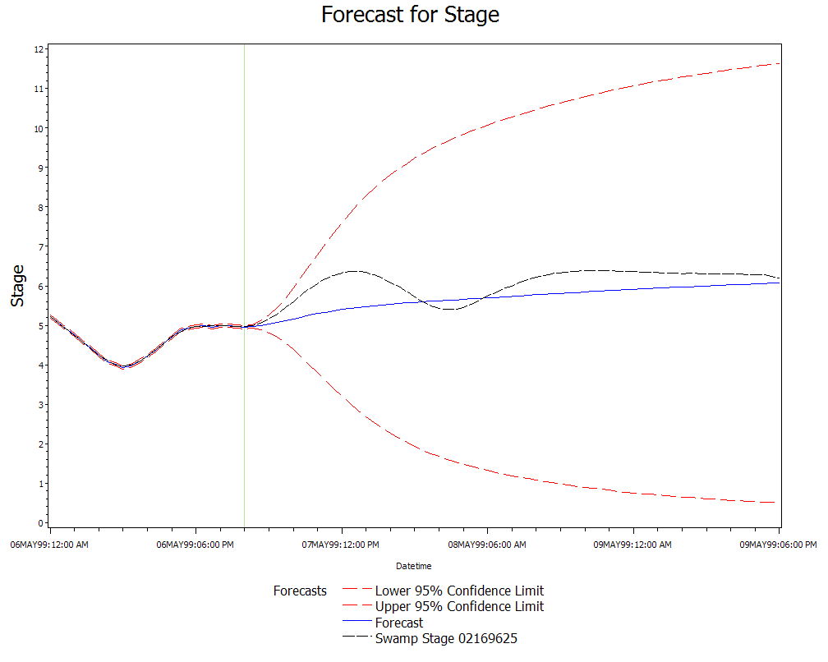

Slide 31
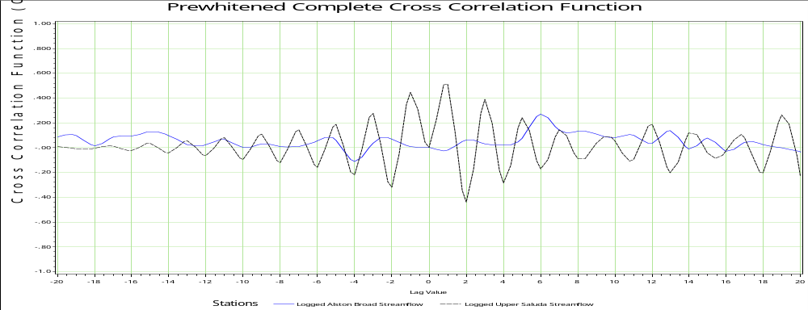
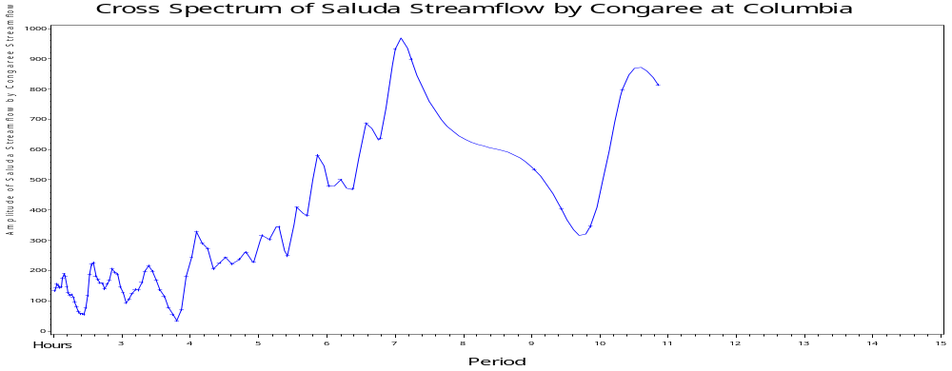

Slide 32
Comparison of Models
Time Series | Streamflow | Stage
September 1996 No Dominant River | Saluda: ARMA(2,1) Delay 3 Broad: ARMA(2,0) Delay 10 Congaree: ARMA(1,3) | Congaree Columbia: ARMA(2,1) Delay 9 Swamp: ARMA(3,2)
July 1995 Saluda River Dominating | Saluda: ARMA(0,2) Delay 3 Broad: ARMA(1,1) Delay 7 Congaree: ARMA(1,3) | Congaree Columbia: ARMA(2,0) Delay 8 Swamp: ARMA(2,0)
April-May 1999 Broad River Dominating | Saluda: ARMA(1,1) Delay 3 Broad: ARMA(4,2) Delay 6 Congaree: ARMA(2,3) | Congaree Columbia: ARMA(3,3) Delay 7 Swamp: ARMA(3,2)

Slide 33
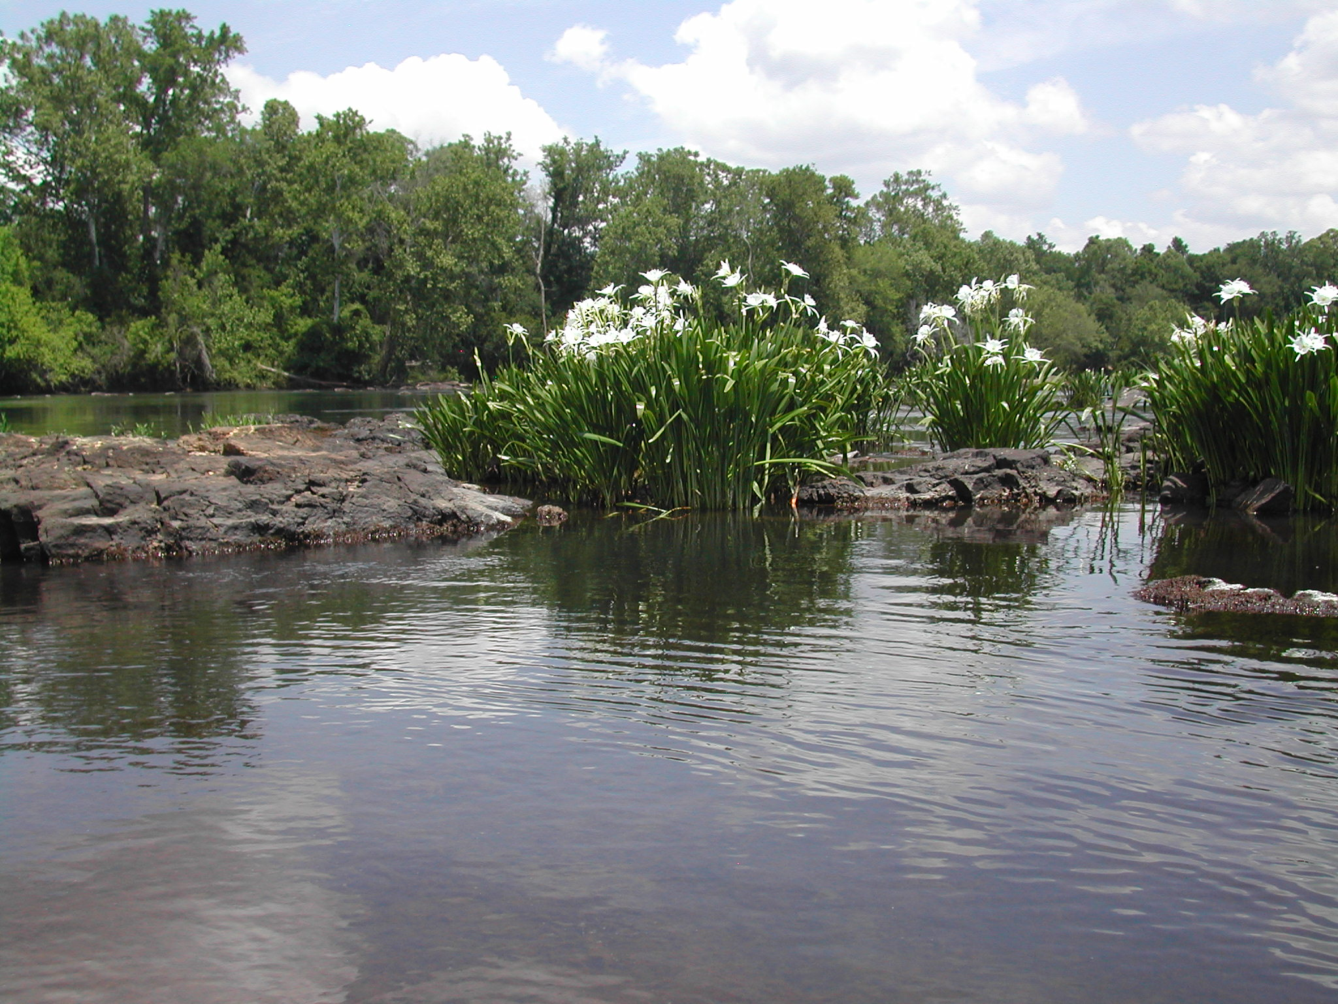
Conclusion

Slide 34
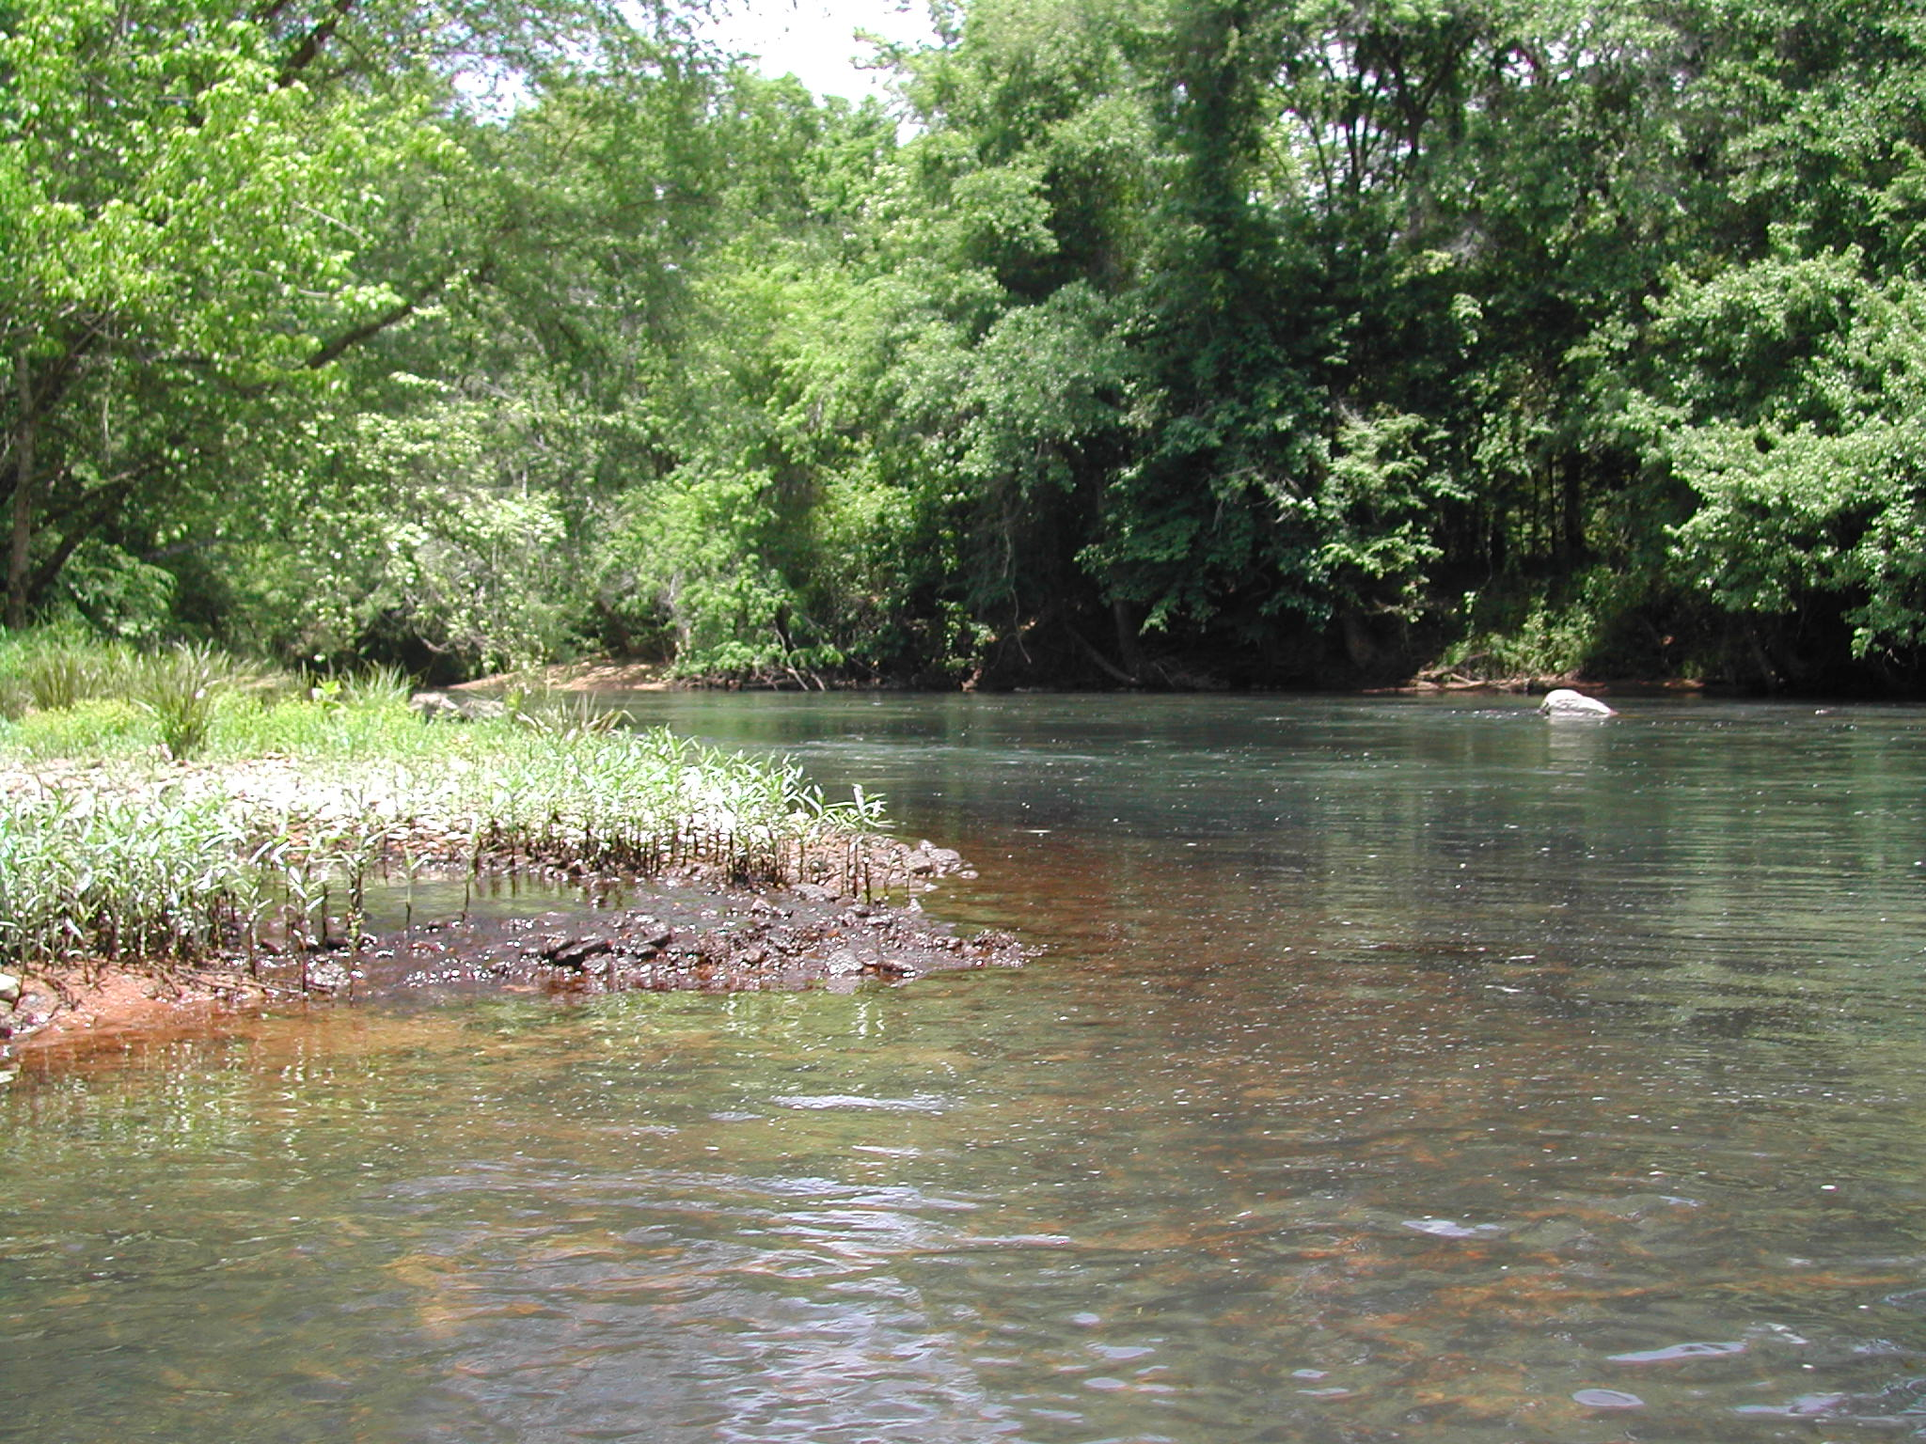
Questions
Differencing
15 minute data

